Slide 1

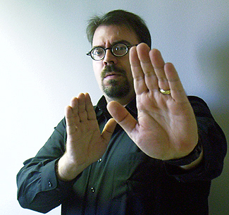
Aggressive Body Language

Slide 2

Attentive Body Language

Slide 3
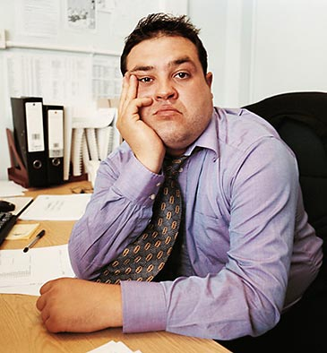

Bored Body Language

Slide 4

Closed Body Language

Slide 5
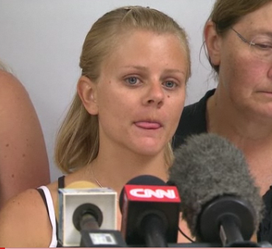
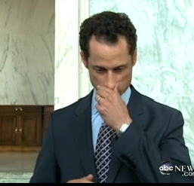
Deceptive Body Language

Slide 6

Defensive Body Language

Slide 7
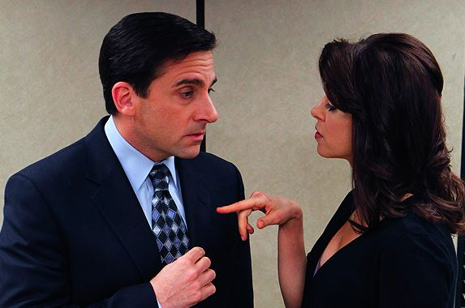
Dominant Body Language

Slide 8
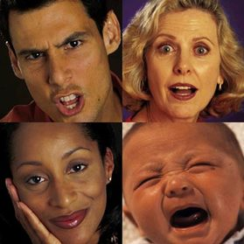
Emotional Body Language

Slide 9

Evaluating Body Language

Slide 10

Greeting Body Language

Slide 11
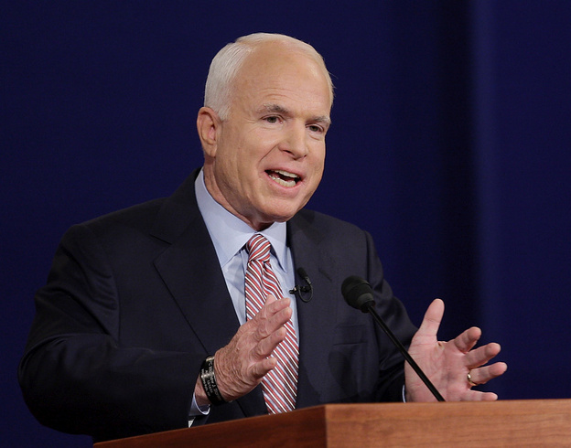
Relaxed Body Language

Slide 12

Romantic Body language

